Slide 1


PCB Shock test Dr. Austin Downey Alex Vereen Zhymire Thompson joud satme
Overview
Experimental
Setup
Results
Future work

Slide 2
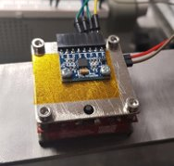
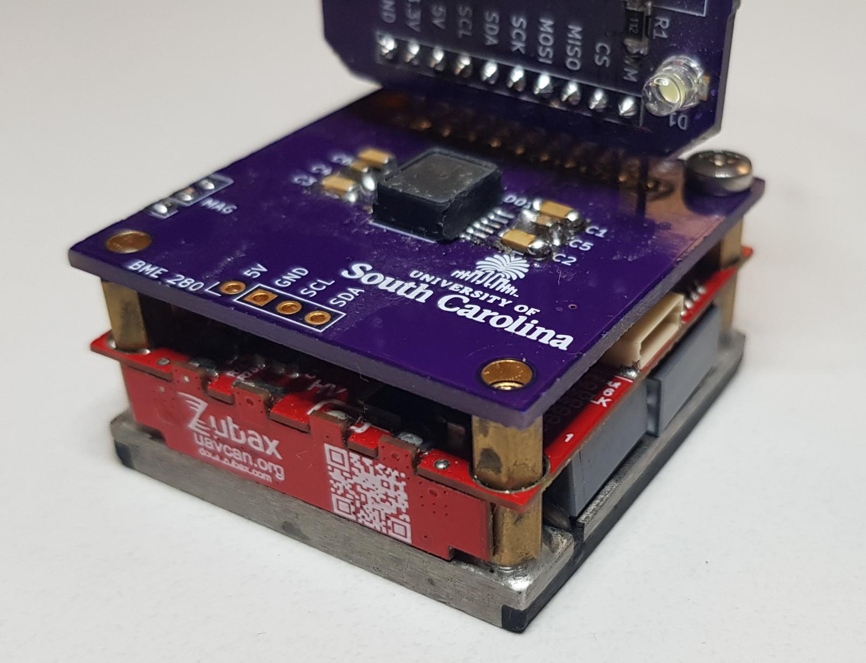
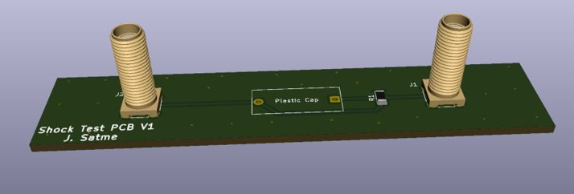
Overview
Experimental
Setup
Results
Future work
Damage detection of printed circuit boards experiencing iterative shock testing
Goal: detect and quantify damage on circuit boards along with the mounted components
Experimental parameters:
Measure impact acceleration on the test bed and PCB
Measure capacitance of a test capacitor onboard the PCB

Slide 3
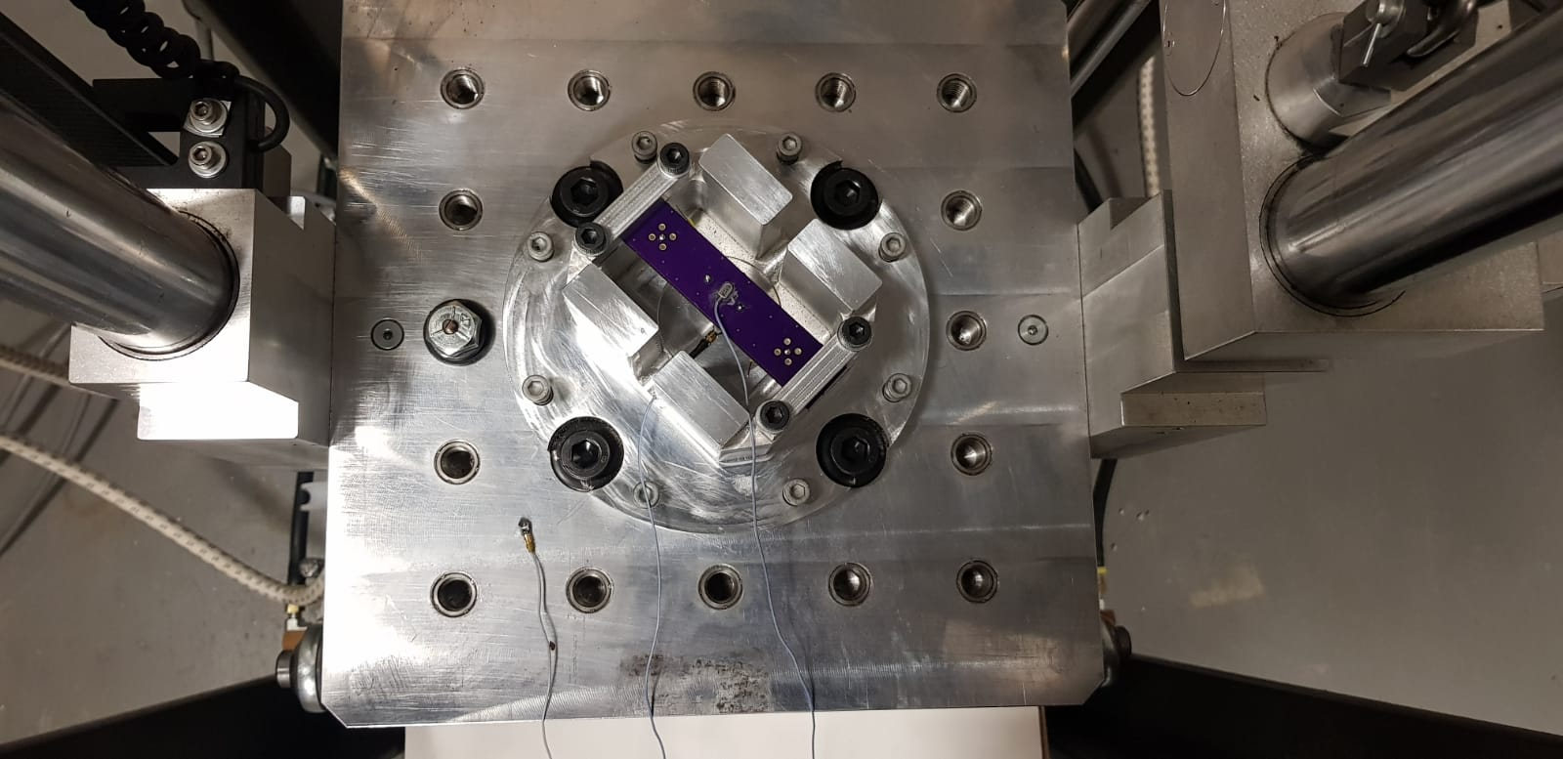
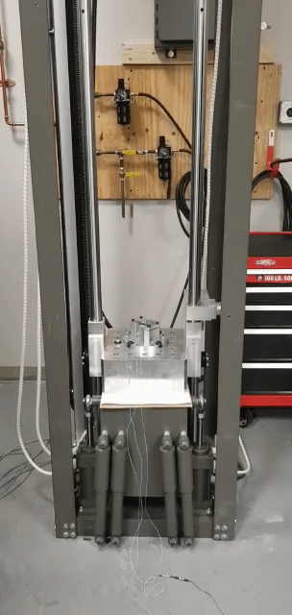
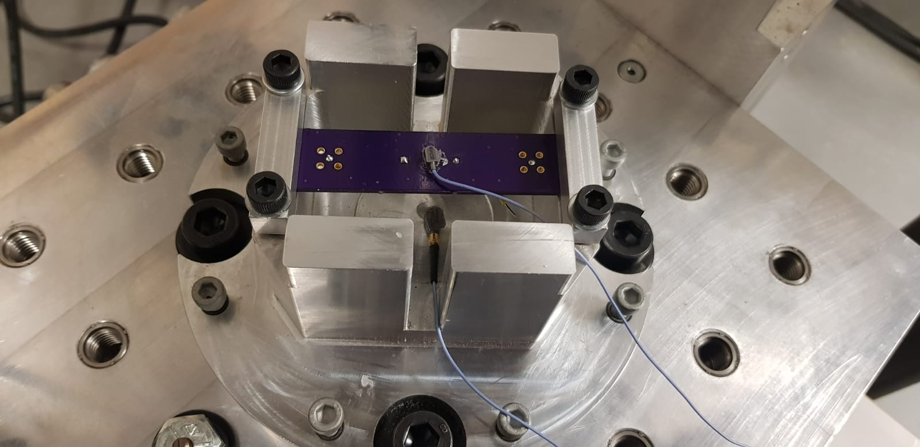
Overview
Experimental
Setup
Results
Future work
Experiment included:
Shock test system
2 accelerometers
Capacitance meter
Test PCB (with passive components)
50 iterations were conducted
550 g maximum impulse
PCB
Acc 1
Acc 2

Slide 4
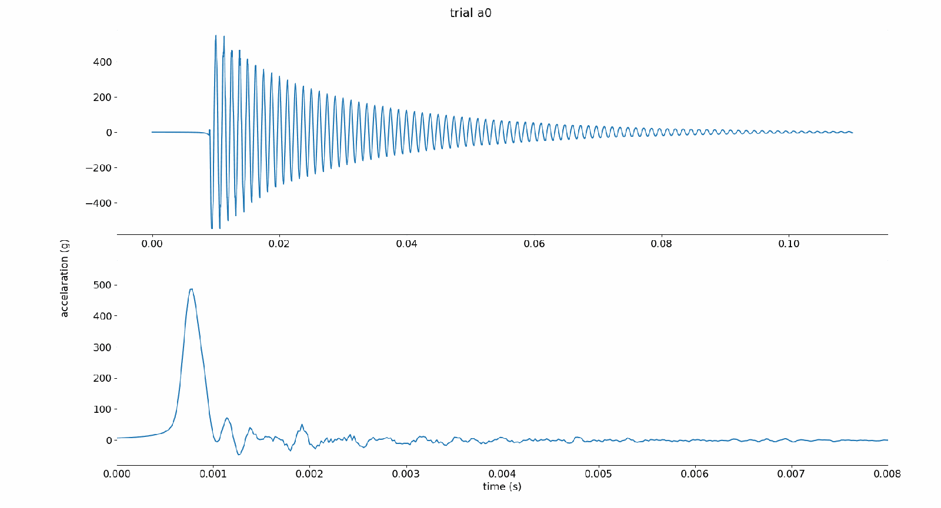
Overview
Experimental
Setup
Results
Future work
50 trials of Acc 1 and Acc 2 respectively

Slide 5
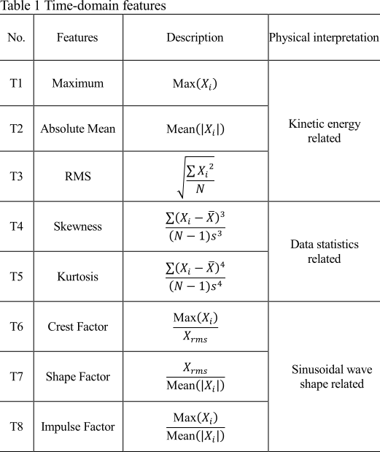
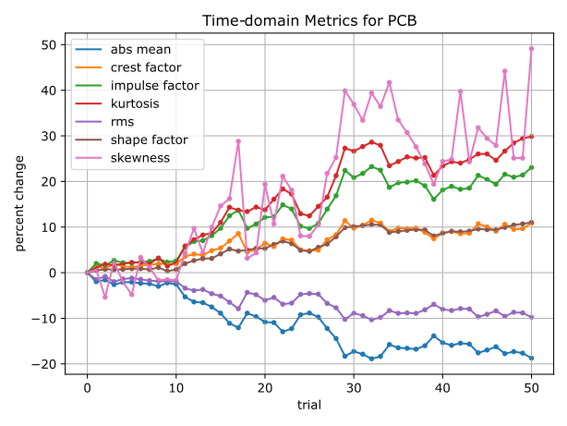
Overview
Experimental
Setup
Results
Future work

Slide 6
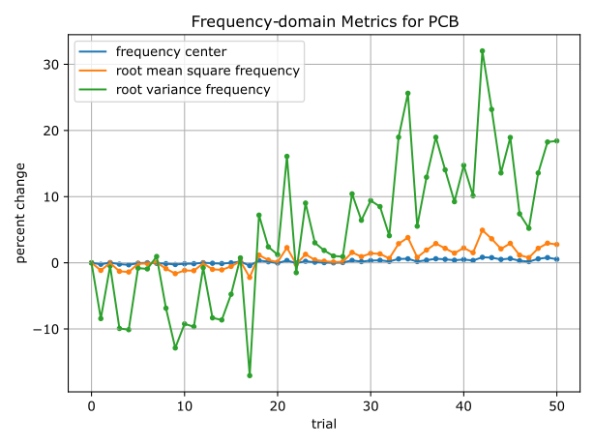
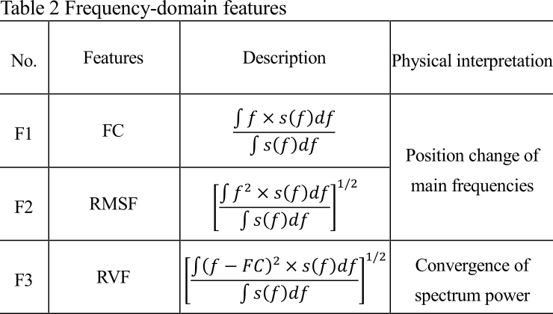
Overview
Experimental
Setup
Results
Future work

Slide 7
Overview
Experimental
Setup
Results
Future work
Automate procedure further to include measuring signal condition between iterations.
Increase number of trials and shock range.
Further investigate trends in the data to quantify PCB damage.

Slide 8
Thank you

